Slide 1

Company Overview
Notes:
To change the image on this slide, select the picture and delete it. Then click the Pictures icon in the placeholder to insert your own image.

Slide 2
Who we are
At Synergy Rail, we bring together a team of skilled railway industry professionals, specially selected for their technical excellence and project management expertise. Our mission is to seamlessly guide clients through project delivery while ensuring the successful integration of new and innovative technologies in the railway sector.
2

Slide 3
Our Vision
At Synergy Rail, we envision a future where railway systems operate with unparalleled safety, efficiency, and innovation.
Our vision is to be the trusted partner, influencing a connected and secure railway, where cutting-edge technology and uncompromising assurance converge to redefine the future of rail transportation.
3

Slide 4




Our Values
Integrity
Integrity, honesty and ethics are at the core of Safety Management. We will not compromise on maintaining our integrity for the benefit of our clients.
Innovation
We strive to be innovative through maintaining continuous professional development (CPD) and embracing technology.
Inspiration
We enjoy finding inspiring solutions to technical challenges or complexity within our given projects. We take a pioneering role providing inspiration to others and showing a readiness to lead for the long term future.
Expertise
We always aim to deliver value by viewing a challenge from the client’s perspective, tailoring our wealth of hard-won experience and expertise to make a difference that you can measure.

Slide 5
Core Services
System Assurance
Engineering Safety Management
Interoperability Verification
Product Acceptance
Throughout our journey, we've gathered a wealth of diverse industry knowledge and technical expertise. This positions us uniquely to address the complex strategic and operational challenges our clients encounter
Engineering and Design Management
Systems Engineering
Project Engineering
Infrastructure Data Management
Operational & Maintenance Readiness
Project Management
Programme Engineering Management
Stakeholder Management

Slide 6
What we do I
Engineering Safety Management
Safety Assurance & Safety Case Development
CSM Risk Assessment and Evaluation
Hazard Identification and Management
Qualitative Risk Analysis
Independent Safety Audit and Assessment
System Assurance
Interoperability Verification
Project Authorisation Strategy Development
Safety Acceptance under ROGS
Liaison with Approved / Notified Bodies
UK Technical File development
Declaration of Verification (DoV)
Product Acceptance
Product Requirement Management
Product Assessment
Product Certification
Product Development

Slide 7
What we do II
System Engineering
Requirement Development & Management
System Integration
System Definition
System Architecture
System Specification
Engineering and Design Management
Project Engineering
Design Review
DRACAS/FRACAS
Client Technical Advisor
Lab/Site Test Witnessing
Engineering Issues Analysis
Technical Document Review
Infrastructure Data Management
Data Quality Assurance and Control
Compliance with Standards and Regulations
Lifecycle Data Management
Engineering Data Capture and Maintenance
CAD and BIM for Rail
Integration with GIS and Geospatial Data

Slide 8
What we do III
Asset Management Strategy
Asset Condition Assessment
Asset Renewals Strategy
Failure Route Cause Analysis
Asset Performance Assessment
O&M Readiness
O&M Readiness Management
Competence & Capability Assessment
New Technology Training and Development
Failure Investigation and Route Cause Analysis
Operational Testing and Simulations
Operational Procedures Development
Maintenance Strategy Development

Slide 9
What we do IV
Programme Engineering Management
Technical Project Management
Technology Strategy and Innovation Management
Programme Planning
Project Management
Technical Project Management
Stakeholder Management
ORR / DfT / NRPAP / RSSB
ISA / ASBO / APBO
TOCs / OPs / Maintainers
NR Technical Authority

Slide 10
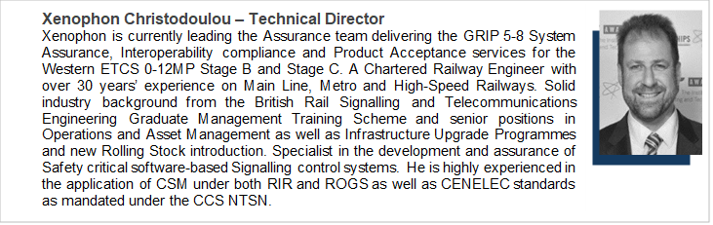
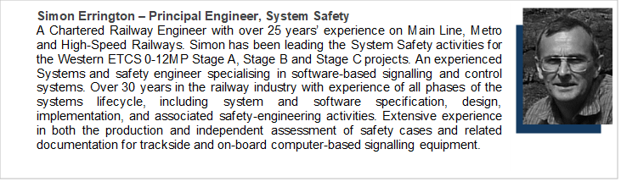
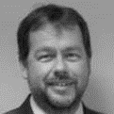

Synergy Rail Team
Ian Shannon – Senior Engineer Interoperability
Ian is a Chartered Engineer with over 30 years of experience in managing complex software-based projects. He has played a key role in overseeing the Interoperability approval activities for the introduction of the Western ETCS project at Paddington. This includes managing the acceptance of major signalling systems onto UK infrastructure. Ian has a proven ability to lead and manage complex projects for new and novel railway projects. He is an experienced consultant and was an integral member of the group that established the Yellow Book on System Safety Management. He has accumulated experience with a proven track record of ensuring that all systems and subsystems within the Western ETCS meet necessary interoperability NTSN standards and regulations. For the last 3 years, Ian has been leading the Interoperability activities for Western ETCS 0-12MP Stage B and Stage C projects and has successfully delivered interoperability verification for Western ETCS Stage A&B and GSM-R Stage B&C in 2021 and 2022 respectively.
Nick Wood - Principal Engineer, Technical Assurance
Nick is a highly accomplished Senior Signalling Principles Engineer with over 25 years of extensive experience in the specification, design, and verification of mainline and mass transit signalling and control systems. Nick has made significant contributions to NR's detailed requirement specifications for Western ETCS project for Stage TB2 and has supervised the activities for the CBTC/ETCS interface design at Westbourne Park. He boasts a wealth of knowledge in both ETCS, and communications based as well as conventional mainline and mass transit signalling and excels in adapting established principles and developing tailored high-level principles for the application of the latest technology. He possesses a strong understanding of operators' concepts and requirements and is adept at adapting applications and design to suit their needs. He is also experienced in designing systems engineering and interface solutions between systems and subsystems. Nick has previously worked on the Stage A and Stage B western ETCS project as a Principal Systems Assurance Engineer.

Slide 11

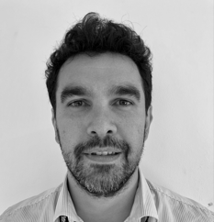
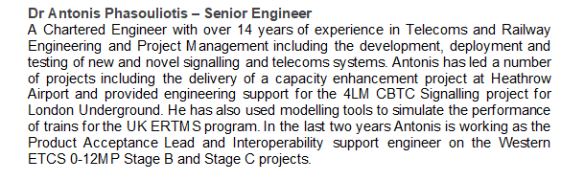
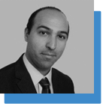
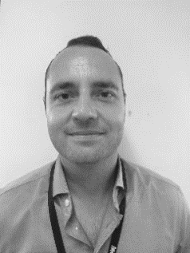
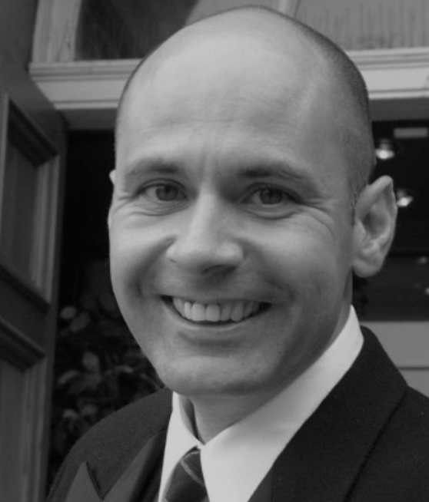
Synergy Rail Team
Panos Rogakos – Senior Engineering Surveyor
A member of the Institute of Engineering and Technology, Panos is a highly skilled Senior Project Engineer with a background in Engineering Surveying and infrastructure data management, showcasing robust practical and technical capabilities. With extensive expertise in Land and Engineering Surveys, Setting Out, GIS and BIM. Panos has successfully led the delivery of the Western ETCS 0-12M infrastructure data. He has provided crucial engineering support and played a key role in developing a data configuration management system and process for the European Train Control System, adhering strictly to company policies, guidelines, processes, and standards.
Michael Lester – Senior Engineer, System Safety
A highly motivated and driven Senior Engineering consultant with 25 years’ experience in Safety, Reliability and Systems engineering positions for major engineering consultancies and organisations associated with the Oil & Gas, Rail, Defence and Aviation industries. More recently, Mike was a key member in the delivery of a comprehensive safety evaluation of the Optimised Track Train Operations (OTTO) system, through his execution of a Hazard Identification study and functional safety analysis. Additionally, Mike created an essential tool for ongoing management and control of hazards through production of the Initial Hazard Record ensuring the safety and reliability of the OTTO system. Extremely knowledgeable about railway systems design and management with a working general knowledge of all aspects of railway engineering and operation. An experienced standards setter, project manager, internal approver and general manager capable of building good relationships over diverse organisations to deliver improvement.
Bill Graham – Railway Operations Interface Specialist
With over three decades of diverse experience in the railway industry, Bill Graham has proven expertise providing consultancy to the sector. Notably, in recent roles, he served as the Project Operations Interface Specialist for ERTMS implementation and as a Senior Consultant at Ricardo Rail, demonstrating exceptional skills in risk evaluation, HAZID meeting chairmanship, and independent safety assessments. His extensive career includes pivotal roles at Network Rail, where he contributed to the successful introduction of ERTMS in the UK, managed operations readiness, and held positions in safety strategy and standards implementation. With a track record encompassing project management, safety strategy, and consultancy, Bill Graham is an expert in railway operations and safety standards.

Slide 12

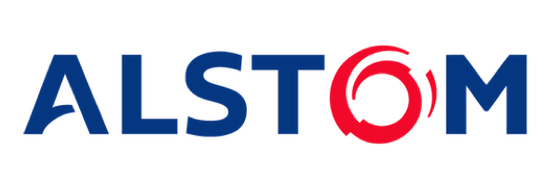
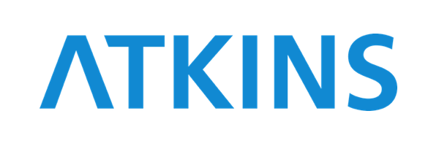



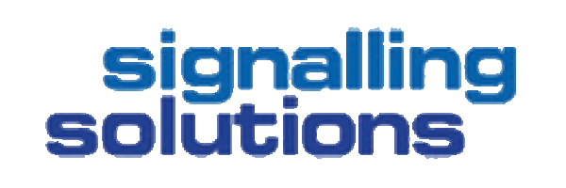

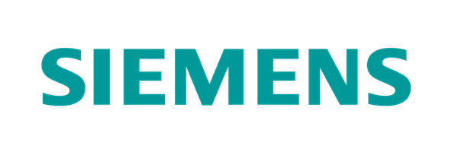


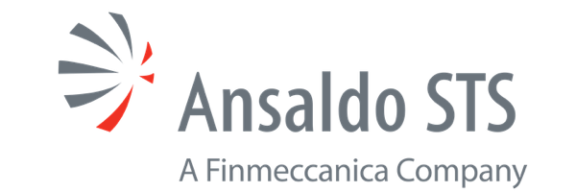
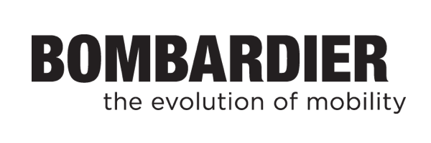

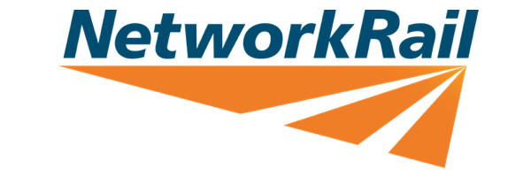
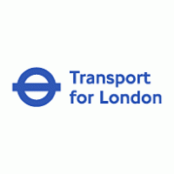

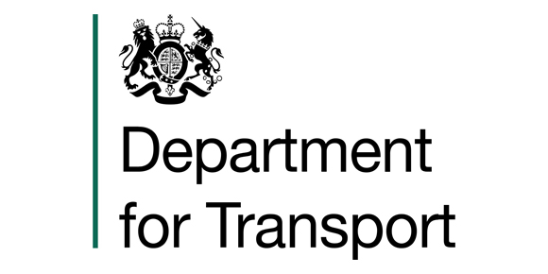
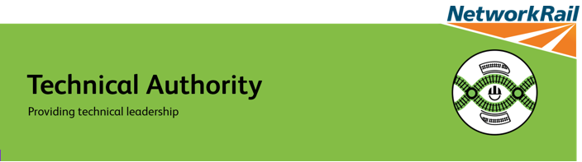

Our Clients

Slide 13
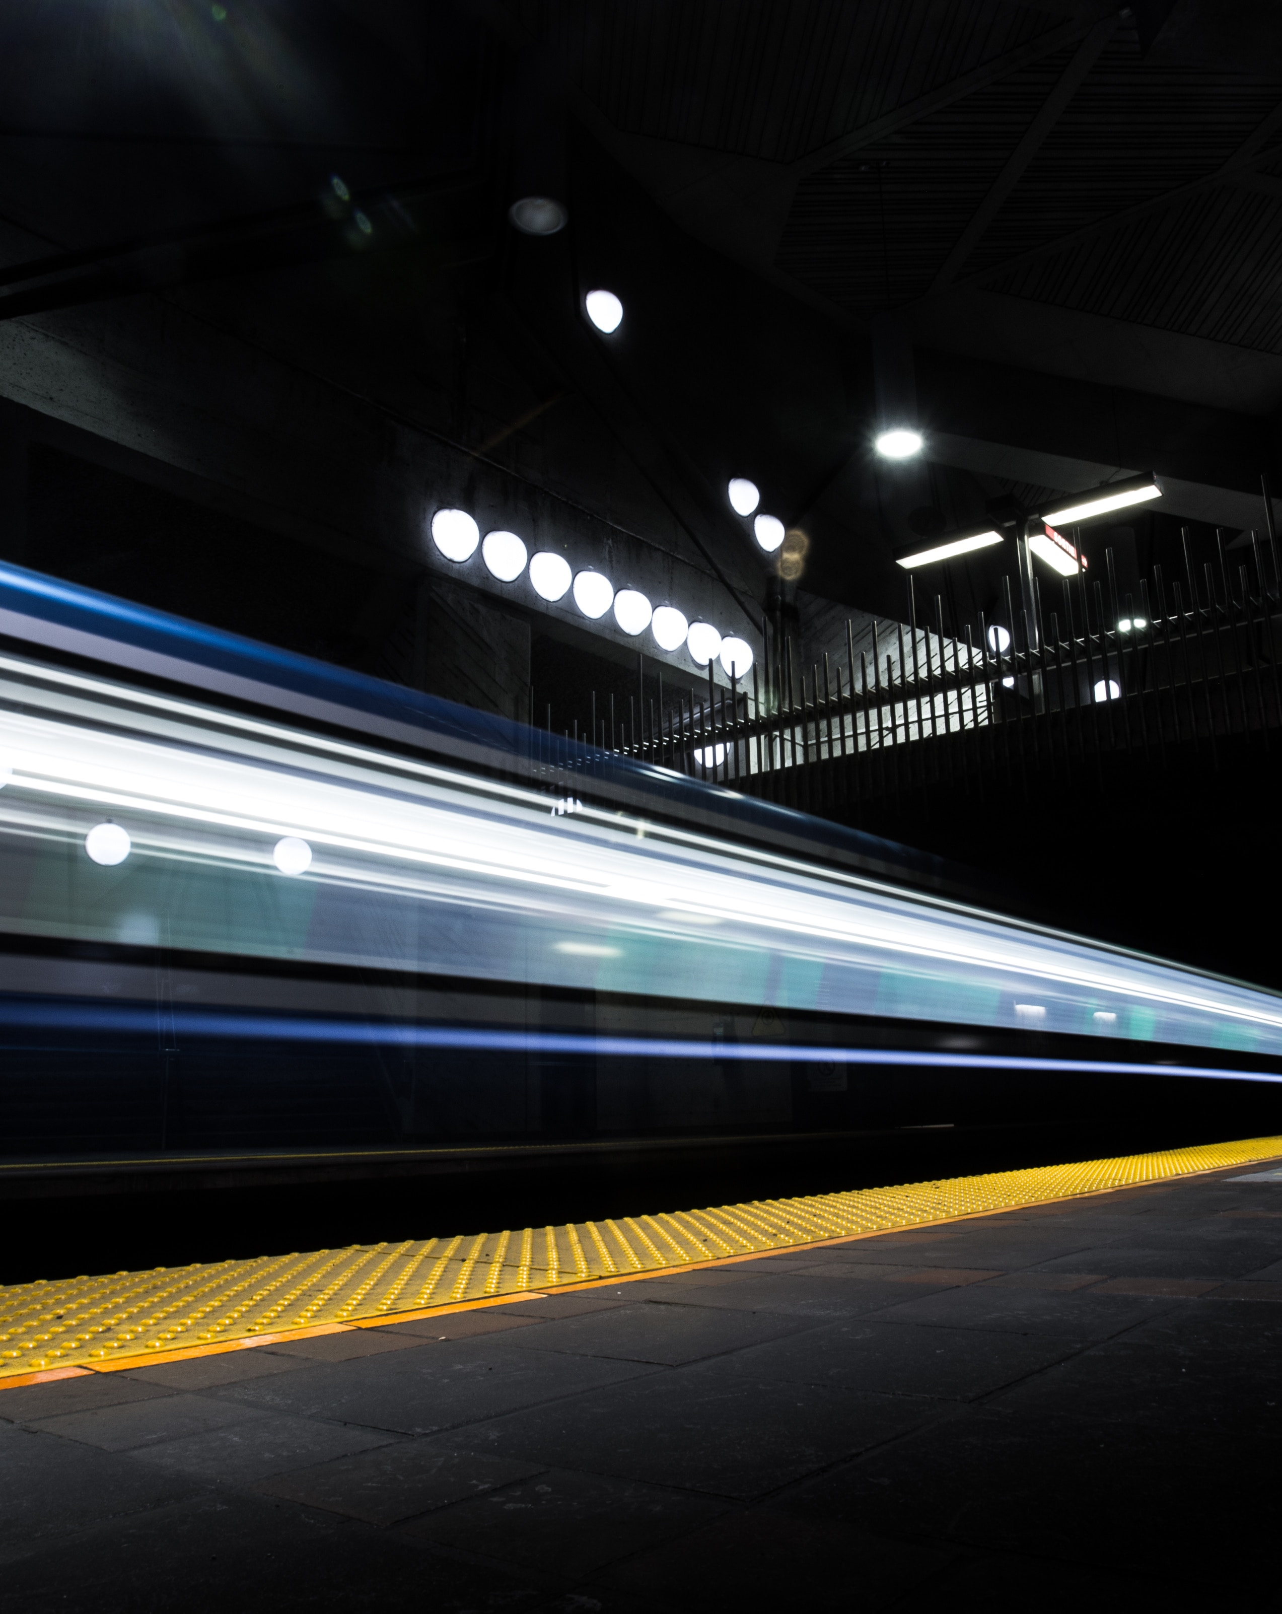
Case Studies
Notes:
To change the image on this slide, select the picture and delete it. Then click the Pictures icon in the placeholder to insert your own image.

Slide 14
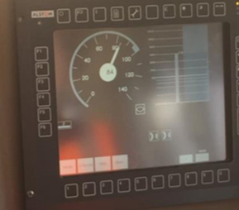
Case Study 1 – W&W ETCS Project Stage A, Stage B&C
Client: Network Rail
Status: Ongoing since 2015
SKILLS AND KNOW HOW SUPPLIED
Synergy Rail Ltd is responsible for conducting and delivering the Network Rail System Safety Assurance Management Services for the ETCS overlay signalling project – Stage A, B&C
The roles and responsibilities include the following services:
Hazard Analysis at the Network Rail system level
Maintaining the Network Rail Hazard Record to reflect the review of end-to-end system scenarios and conducted hazard analyses
Review of Alstom (supplier) engineering safety documentation, safety cases
Production of Network Rail Level Safety Justification Report documentation throughout the project lifecycle
Analysis of data flows in the context of safety
Interoperability Compliance Verification and Obtaining APIS from the ORR
Manage Product Acceptance for ETCS RBC, IXL, NTG, LEU, Balise
Review and management of ETCS product acceptance and System Review Panel (SRP) submissions
PROJECT OVERVIEW
ERTMS, the chosen train control and command solution, and its implementation along the Western Route begins with the provision of an ETCS overlay between the GWML and Heathrow Airport (Stage A – the initial stage of NR’s Western ETCS Project) and will then be extended to support ETCS operations in the 0-12 MP area (Stages B and C) and then will migrate west in stages.

Slide 15
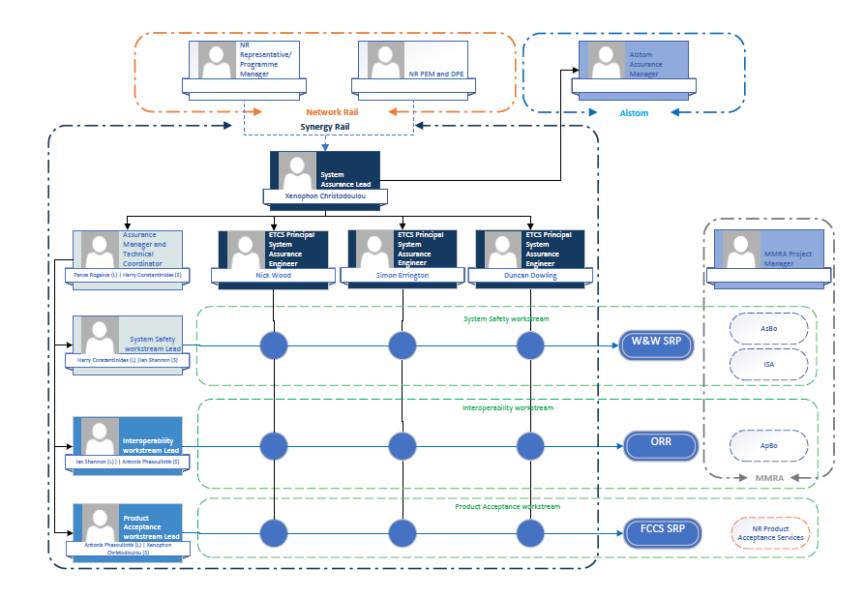
Case Study 1 – ETCS Project Synergy Rail Team Structure

Slide 16
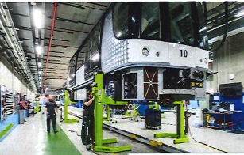
Case Study 2 – Heathrow T5 TTS Capacity Enhancements
Client: Heathrow Airport
Status: Ongoing since 2018
SKILLS AND KNOW HOW SUPPLIED
The roles and responsibilities include the following services:
Participate in Safety assessment meetings
Review of PDR, FDR, FAT, SAT documents
Production of ISA Plan
Audit the supplier V&V Process and Safety Management process (including Software Compliance to EN50128)
Witness FAT and Site Dynamic testing
Production of Audit reports
Production of ISA safety reports throughout the lifecycle of the project
PROJECT OVERVIEW
The HAL T5 TTS capacity enhancements project involves the upgrade of the signalling and telecoms systems of the T5 Track Transit system and the capacity increase of the fleet with 20 new trains. Synergy Rail were contracted in 2018 by Heathrow Airport to undertake the role of the Independent Safety Assessor to provide an independent professional opinion on whether the project has been developed in accordance with relevant standards to warrant the claimed safety integrity level and that all risks have been reduced to a level that is tolerable and As Low As Reasonably Practicable (ALARP).

Slide 17
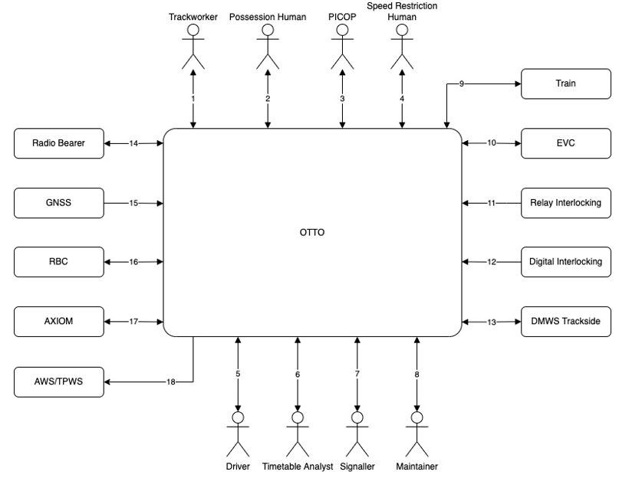
Case Study 3 – Optimised Train Track Operations (OTTO)
Client: NR Technical
Authority
Status: Completed (2022)
SKILLS AND KNOW HOW SUPPLIED
The initial phase of the work involved the production of a Preliminary System Architecture and System Definition, permitted system configurations and high-level functional requirements, constraints and assumptions. Hazard identification and analysis was also undertaken to determine a preliminary SIL for the safety functions of each subsystem.
Following the initial stage of the works Synergy Rail received a new commission to develop the customer requirements for all the Systems associated with OTTO including speed restriction manager, track worker warning/protection, level crossing warning/protection, possessions management, degraded mode, state of railway compiler, TPWS Flex+ onboard and efficient RBC. The work also included undertaking additional safety analysis including an ALARP case, further development of the business case and the early train fitment evaluation, for an OTTO system.
The work was concluded on time and all Synergy Rail deliverables have been submitted to NR Technical Authority. The safety analysis and ALARP case produced by Synergy Rail was independently reviewed and supported by RSSB and commended by the NR Technical Authority Engineer.
PROJECT OVERVIEW
NR TA has employed Synergy Rail to undertake preliminary safety and technical business analysis to obtain funding and subsequently to lead the development of the OTTO system and sub-system specification that will be used to procure a prototype system for product approval and pilot application. This engagement followed the successful completion of the RBLS System Specification Development which formed the basis for the work on OTTO.

Slide 18
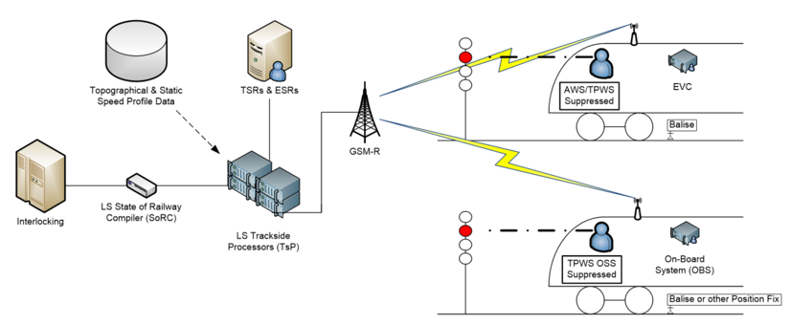
Case Study 4 – Radio Based Limited Supervision System Development
Client: NR Systems
Authority
Status: Completed
SKILLS AND KNOW HOW SUPPLIED
The role involved provision of technical direction and assurance of the System Integrator (Altran) who were responsible for the development of the system specification. The Synergy Rail Technical Lead (Xenophon Christodoulou) was nominated as DPE by FCCS SRP with delegated authority for undertaking Level 1 assurance on system integrator outputs.
Synergy Rail’s scope for the work included the production of System Definition, Project Assurance Strategy, Project Safety Plan, Modelling Strategy, Stakeholder Management Plan, Concept of Operations, Functional Safety Analysis for SIL Derivation, Remits for ISA/AsBo/NoBo, provision of specialist input at System Integrator top down agile sprints for the development of system use cases and requirements and HAZID/HAZOP workshops.
The Synergy Rail team were commended for their work and in particular the technical input provided in support of the rail integrator production of system use cases and in the area of ETCS Design and Operations Principles.
PROJECT OVERVIEW
Synergy Rail were contracted in 2020 by the NR ETCS Systems Authority (now part of NR Technical Authority) to provide client engineering and assurance services in the development of the RBLS system. Synergy Rail were selected for this task because of our specialist technical knowledge of ETCS on the W&W System Safety Framework as well as our experience in signalling systems development and assurance.

Slide 19
Case Study 5 – Siemens Mobility Assurance Support Services
Client: Siemens Mobility
Status: Completed
PROJECT OVERVIEW
Synergy Rail provided System Assurance and Interface Management Services to Siemens Mobility who were awarded a £1.5Billion contract to design and construct the new Rolling Stock for the Deep Tube Lines
SKILLS AND KNOW HOW SUPPLIED
Synergy Rail developed the Assurance Strategy and Interface Management Plan together with the Interface Control Documents for each interface.
19

Slide 20
Case Study 6 – NR Management Consultancy Framework
Client: Network Rail
Status: Completed
SKILLS AND KNOW HOW SUPPLIED
The Consortium has been contracted to provide services for:
Business Change Management including Stakeholder management and communications
Be a Business Change Delivery Partner
Project and Programme Delivery
Portfolio Management
Business Change Assurance
Business Intelligence Services
PROJECT OVERVIEW
Synergy Rail as an Equal Member of a consortium with Alchemmy Consulting Ltd and i3Works Ltd who won a place on a 5 Year framework to provide Management Consultancy services to NR
20

Slide 21
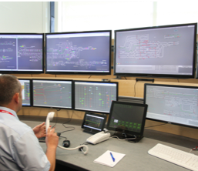
Case Study 7 – Traffic Management Project: Wales and Anglia
Client: Network Rail
Status: Completed
SKILLS AND KNOW HOW SUPPLIED
Synergy Rail Ltd was placed responsible for conducting and delivering the Network Rail level safety analyses and documentation (utilising the CSM approach).
The roles provided specialist safety assurance services:
Functional SIL Assessment of all Traffic Management System functions;
Hazard Analysis at the Network Rail system level
Maintaining the Network Rail Hazard Record
Review of Supplier engineering safety documentation, safety cases and Independent Safety Assessor recommendations
Production of Network Rail Level Safety Justification Report documentation throughout the project lifecycle
Analysis of data flows in the context of safety
Review and management of Traffic Management System product acceptance and System Review Panel (SRP) submissions
PROJECT OVERVIEW
The Traffic Management (TM) Programme, part of the Infrastructure Projects (IP) National Signalling Programme, is undertaking the development and delivery of an integrated Traffic Management approach to the UK railway infrastructure. It is intended that the new technology associated with the development of TM, interface with a number of technologies, will enable a cost effective means of early re-control and remove the dependency on the signalling renewals work bank.
21

Slide 22
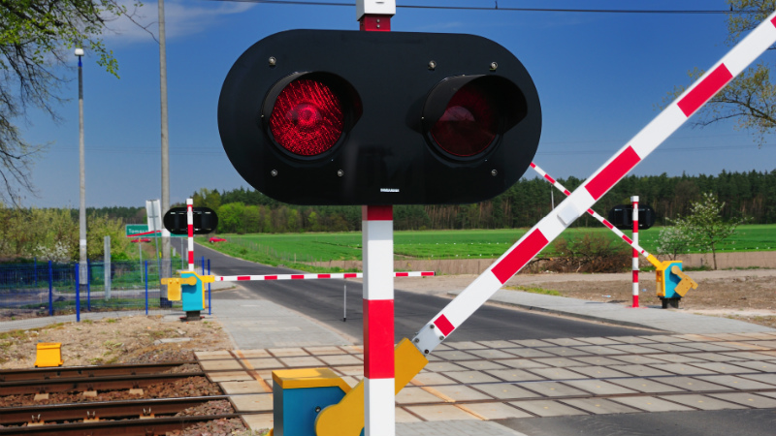
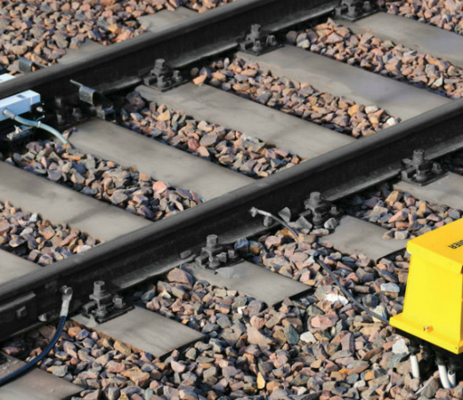
Case Study 8 – Train Detection Failure Investigation and Rectification
Client: LU (TfL)
Status: Completed
SKILLS AND KNOW HOW SUPPLIED
Synergy Rail Ltd supported Tfl in the investigation of Southfields track circuit right side failures via root cause analysis
The role provided specialist support to:
Identify the root failure causes using proven root cause techniques
Carry out an analytical assessment of the EBI 200 track circuit system to aid understanding of the conditions causing the failure of the system and establish integrity of the system
Characterise the integrity of EBI 200 track circuit system through surge testing of the unit in an accredited EMC test house to establish susceptibility of the unit
Develop a model of the system (equivalent circuit or otherwise) to assist in identify coupling mechanisms
Carry out testing to identify failure conditions and causes of failures Identify recommendations for implementation.
PROJECT OVERVIEW
The EBI200 Track Circuits installed by the SUP Immunisation Project on the Wimbledon Branch in December 2011 is exhibiting an unacceptably high failure rate. An investigation is being under taken by SUP as follows
22

Slide 23
Case Study 9 – Layered Information Exchange (LINX) Safety Case
Client: Network Rail (RSIT)
Status: Completed
SKILLS AND KNOW HOW SUPPLIED
Synergy Rail Ltd conducted Safety analysis of the IT has been ND PRODUCED Safety Activities Plan. In summary, the approach followed has been to:
Produce a System Definition – initially defined in [R13] and now superseded by section 2;
Identify the hazards arising from the system and its use (typically arising from failures associated with supply of generic information by LINX);
Identify aspects of the system which mitigate the hazards i.e. the safety requirements;
Identify how the system fulfils its safety requirements;
Produce a 50128 SIL 0 Compliance Report
Document the results
PROJECT OVERVIEW
New Rail Operating Centres (ROC) across Britain. These ROCs will use advanced Traffic Management (TM) technology.
To achieve its objectives any new TM solution will need to interface to NR’s existing systems, or other TM solutions deployed outside of the ROC area of control. NR has developed LINX (Layered INformation eXchange) in order to simplify the connection of each TM solution with these other systems. The LINX is an inter-system message broker based on IBM MQ technology To support use of LINX on these, and future applications, NR has engaged Synergy Rail to produce this Safety Justification Report (SJR) for LINX.
23

Slide 24
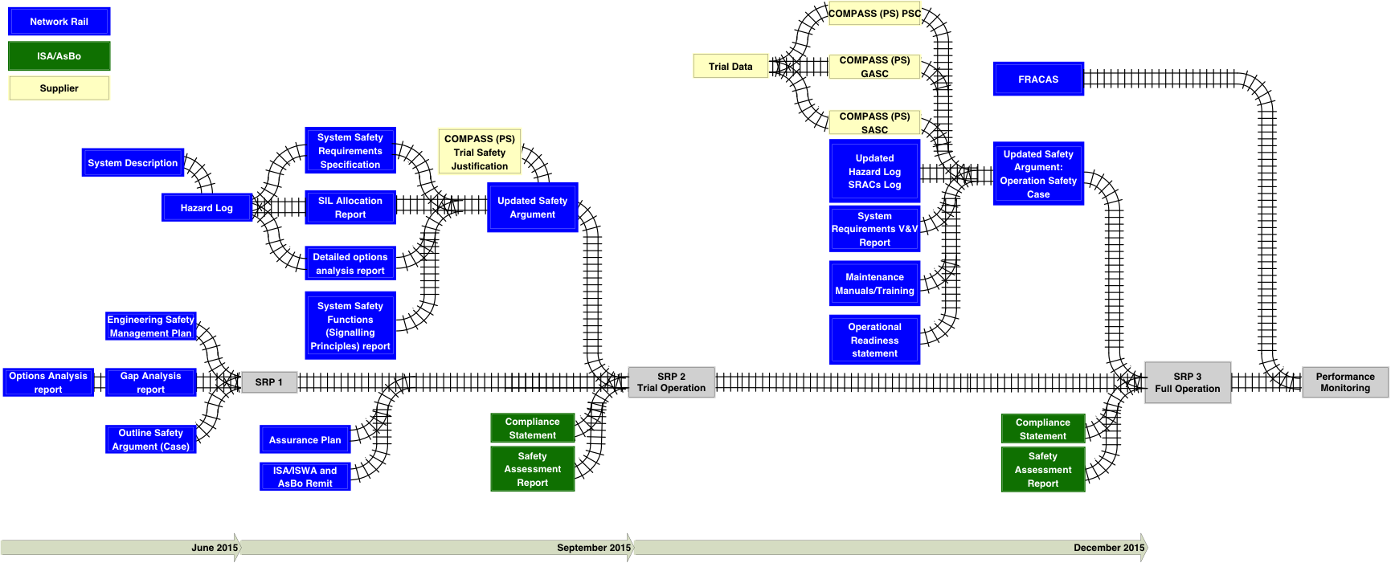
Case Study 10 – COMPASS (PS)
Client: Network Rail
Status: Completed
PROJECT OVERVIEW
The COMPASS 1C (PIDR) proposed as an alternative to “Clip and Scotch” under certain failure conditions. This will:
Reduce delays for certain types of failure;
Introduce improvements to staff safety;
The product has two modes of operation, LOC and Compass.
Phase 1C: Development and Deployment of the Points Inhibit and Detection Repeat System (PIDR) into operational trial.
SKILLS AND KNOW HOW SUPPLIED
Synergy Rail have been commissioned by Network Rail (NR) to support the COMPASS project progress to Operational trial running in alpha phase (15 point ends) and beta phase (60 point ends). Activities included:
Analyse Shadow mode Operations and report
Production of process for Acceptance by NR SRP
Evidence Gap Analysis
Produce Option Selection Report
Update NR Engineering Safety Management Plan
24

Slide 25
Case Study 11 – SCADA Safety Integrity Analysis and System Safety Management
Client: TfL
Status: Completed
PROJECT OVERVIEW
Transport for London (TfL) has earmarked up to £54 million for the installation of new power Supervisory Control and Data Acquisition (SCADA) systems and related communication network.
The new system will replace the existing power network control facility, and replace hardware including Remote Terminal Units (RTUs).
SKILLS AND KNOW HOW SUPPLIED
Synergy Rail have been commissioned by Network Rail (NR) to support part of System Safety Activities:
Hazard Identification and Support activities
SIL analysis and apportionment
Produce the Engineering Safety Management Plan
25

Slide 26
Case Study 12 – Bid Support – NR Southern IP SMD Framework
Client: SKANSKA
Status: Completed
SKILLS AND KNOW HOW SUPPLIED
Synergy Rail Ltd having had significant experience in responding to recent NR ITTs, and having successfully secured a place on the NR Management Consultancy Framework, contributed significantly to you’re the Client’s ITT response.
PROJECT OVERVIEW
Synergy Rail Ltd was contracted here by a SKANSKA Consortium to support them with the input to their bid for an Infrastructure Renewals Framework for System Assurance Elements
26

Slide 27
Case Study 13 – Bid Support – Abellio Traffic Management Concept of Operation
Client: Abellio
Status: Completed
SKILLS AND KNOW HOW SUPPLIED
Synergy Rail Ltd having had significant experience in responding to recent NR ITTs,, contributed significantly to you’re the Client’s ITT response.
A Concept of Operation was also produced in conjunction with the Client to aid this ITT.
PROJECT OVERVIEW
Contracted by Abellio to support them on their Bid for East Midlands Franchise by developing a proposal for a Traffic Management System that would be procured and operated by the Train Operating Company.
27

Slide 28
Case Study 14 – North West Electrification Programme and Enhancement Projects
Client: Network Rail
Status: Completed
SKILLS AND KNOW HOW SUPPLIED
Synergy Rail Ltd provided Interoperability and CSM Support for North West Electrification and Enhancements. We achieved this by participating in two roles:
Functional Lead for System Safety throughout the NR Infrastructure Projects Northern Programmes (IPNP) portfolio
Provide direct System Safety lead and services to the IPNP Enhancements portfolio including:
  Production of all Safety Documentation
  Hazard Management Activities (Meeting, Workshops and Recording)
  Safety Justification Reports
  System Review Panel
  1210 Risk Assessments (bridges and platforms)
  Interoperability assessment
  Liaise with the Independent Assessment Bodies (AsBo, NoBo, ISA etc.
.
PROJECT OVERVIEW
Contracted by Abellio to support them on their Bid for East Midlands Franchise by developing a proposal for a Traffic Management System that would be procured and operated by the Train Operating Company.
28

Slide 29
Case Study 15 – Neasden Depot AzLM Axle Counter Mis-counts Investigation
Client: London Underground
SKILLS AND KNOW HOW SUPPLIED
Synergy Rail Ltd provided Engineering technical support to achieve the following:
Establish Axle Counter System under test is within Spec (LU APD) – Inspection and Test Measurement
Establish Trains under test (96115 and another 96 Stock for comparison) are within Spec (LU APD) – Inspection and Test Measurement
Train moves over pre-tested axle counter sections, monitoring AzLM ACE (evaluator) performance in SER (correct counting) and AzLM EAK on the track with a scope to monitor EM field variation with passage of train, in an attempt to isolate potential faults.
In parallel to the track monitoring fleet undertake on-board monitoring of traction and auxiliary systems current to identify potentially abnormal measurements
Status: Completed
PROJECT OVERVIEW
The Neasden Depot Signalling Upgrade Project has provided a new Signalling Locktrac 6172 PMI Control System post Oct 2011. The method of train detection is based on a multi-section axle counter system from Thales (AzLM).
in February 2013 a number of instances instance of multiple disturbed Axle counter blocks due to a passage of a train were experienced.
Following up on a previous investigation, The business has requested a further investigation to identify the route cause as the inability to berth 96115 at Neasden Depot is having an impact and also keen to understand whether there is an underlying condition that could cause wider problems with the rest of the fleet.
29

